Slide 1

2017
New
Year’s
Resolutions
Notes:
SLIDE PURPOSE: This is where everything starts – us defining with our customers how we can make an impact in their business regardless of the technology!
SPIEL: Technology should be transformative, not a to-do list. Because, really, just about any firm can change the way your IT works. Our mission is for IT to change the way your business works. The difference is a game-changer.

Slide 2

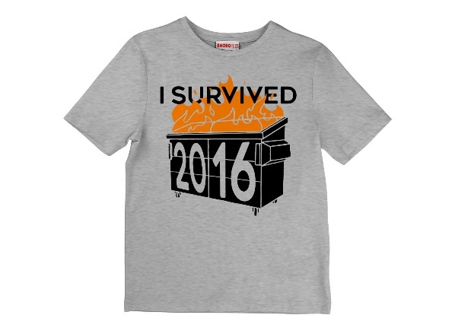

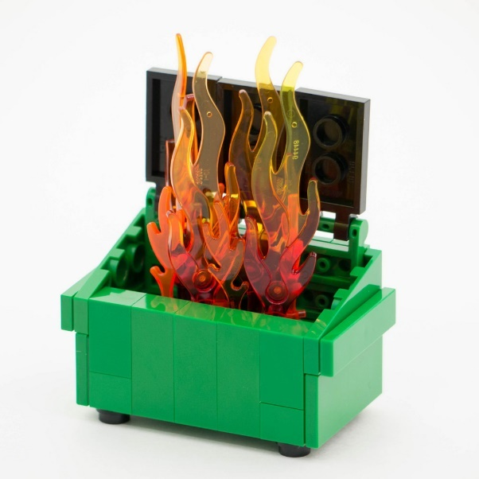

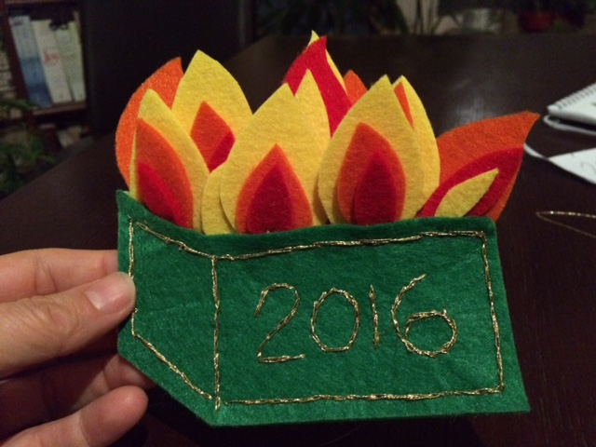
Notes:
SLIDE PURPOSE: This is where everything starts – us defining with our customers how we can make an impact in their business regardless of the technology!
SPIEL: Technology should be transformative, not a to-do list. Because, really, just about any firm can change the way your IT works. Our mission is for IT to change the way your business works. The difference is a game-changer.

Slide 3
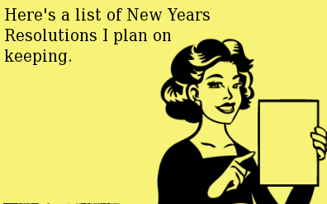
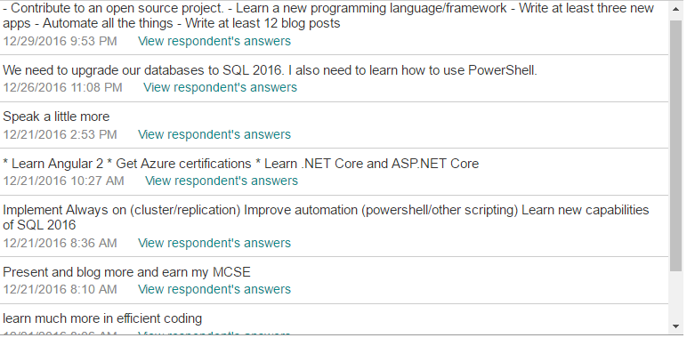
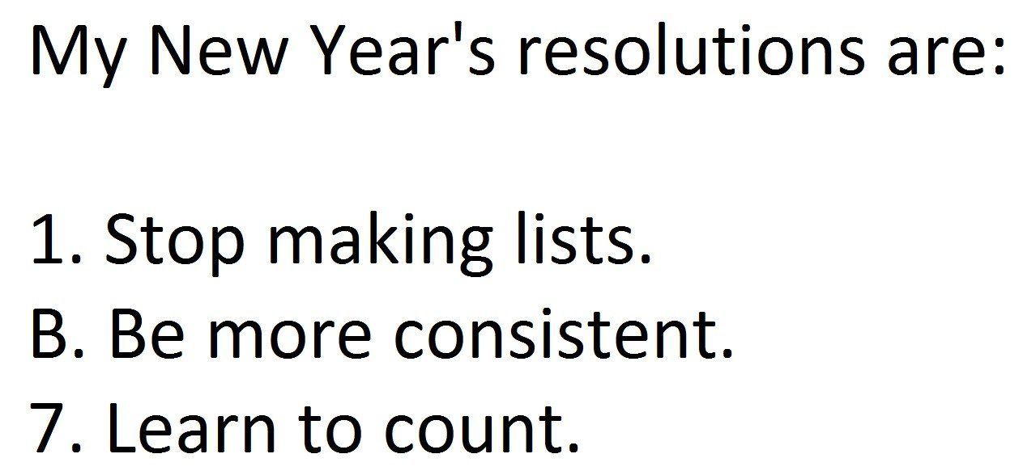
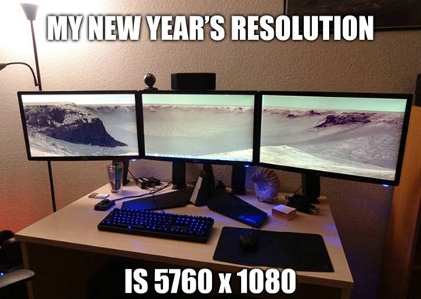
Notes:
SLIDE PURPOSE: This is where everything starts – us defining with our customers how we can make an impact in their business regardless of the technology!
SPIEL: Technology should be transformative, not a to-do list. Because, really, just about any firm can change the way your IT works. Our mission is for IT to change the way your business works. The difference is a game-changer.

Slide 4
4 Categories
.NET Developers
PowerShell
Soft Skills
SQL DBAs

Slide 5
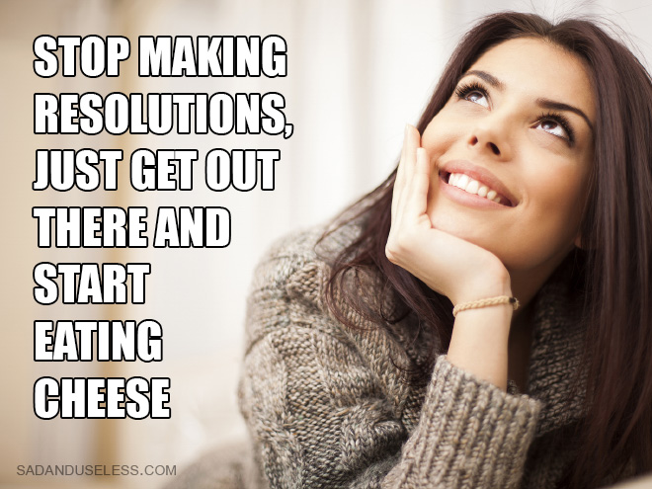
.NET Developers

Slide 6

Resolutions
Learning a new Programming Language (or 7)
Contribute to an Open Source Project
Become a more efficient coder

Slide 7

Learning a New Language
Why?!?!?!
Survey a new language, or 7
Ruby, Io, Prolog, Scala, Erlang, Clojure, Haskell
Different programming models
Dynamic Typing, Pattern matching, Functional Programming, Concurrency

Slide 8

Be a Better Programmer!
Practice, Practice, Practice
Read, Write, Practice?!?
Design Patterns
SOLID
TDD
Clean Code(r)

Slide 9
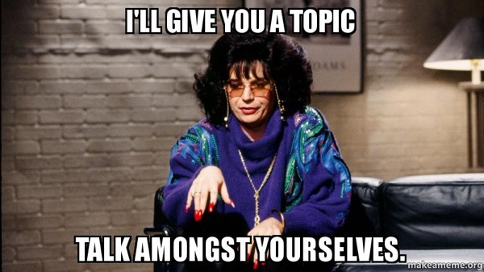
Contribute to an OSS Project

Slide 10
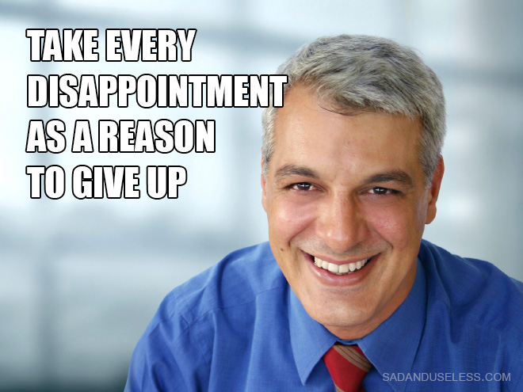
PowerShell

Slide 11
PowerShell

Slide 12
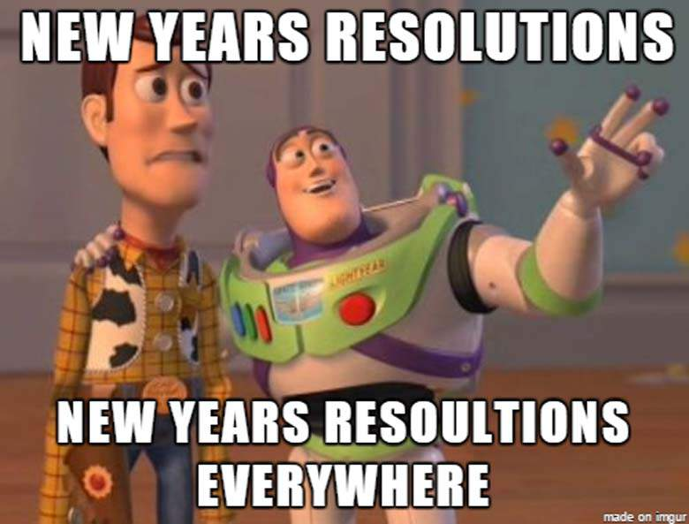
Soft Skills

Slide 13
“Write at least 12 blog posts / blog more”
Top 4 Tips for Coming Up With Blog Topics:
Create a technical reference blog, as opposed to a timely/news/topical blog.
Lower your expectations of newness, Copernicus. Blog posts do not have to be cutting edge, latest/greatest, new discoveries.
Blog posts should be useful, for example, they reference a specific message, problem/workaround, factoid, or feature.
Don’t be afraid to take a similar approach to link bait:
Top 10 Features of…
Top 7 Reason to…
Top 5 Things To Do with…
My Top 72 Favorite Things about…

Slide 14
“Write at least 12 blog posts / blog more”
More advice on blogs:
Your professional blog is not your personal blog
No vacation pics, political rants, or sports diatribes
Same for social media! Twitter, LinkedIn, etc.
Many of your hits and comments may come much later on
Look to get syndicated
Examples:
SQLServerCentral.com
GeeksWithBlogs.net
Draw inspiration from your day to day
Answered a question via email? Think it’d be helpful to others too?

Slide 15
“Speak a little more / present more”
How to Incubate a Technical Talk in Your Brain
Write a summary of what you want to cover. Don’t be too broad or general.
Write a demo of the thing. Do it quick and simply – don’t overcomplicate your demo with tangents, focus on the core
Make the demo robust enough to answer its own questions, anticipate questions like “Why did you…”
Give a presentation at work to a lunch crowd
Give the presentation at a User Group meeting Lightning Round
Grow the presentation around audience questions/interest.
Give the presentation as a full-length User Group talk
Give the presentation at SQLSaturday
….
Profit!

Slide 16
“Speak a little more / present more”
Public Speaking Is Too Hard
Give Toastmasters a try for a little while. You’ll learn/grow every time, based on your own participation.
At Sparkhound, every Monday night.
Practice your demo. This sounds obviously, but really, do it.
Record yourself speaking. Cringe. Adjust. Repeat.
Ask more experienced speakers who you trust for candid constructive feedback. Many in this room would happy to.
Set the stage. All talks should include some framing of the topic: a brief history, its place in the market, its alternatives, where/when you use it… before you talk about HOW.
Decide your audience. Your talk’s scope/depth can be inconsistent unless you decide on who your audience is.

Slide 17
“earn my MCSE”
Good news!
You can earn a SQL MCSE in 2017 w/ only 3 exams!
Get a two-exam MCSA in one of four different ways (including SQL 2012/2014 or SQL 2016 exams!)
+
Pass one of five different elective exams (including SQL 2012/2014 or SQL 2016 exams!)
Bad news! Only 2 SQL 2016 exams are out. When the rest arrive the path to an MCSE will likely no longer include SQL 2012/2014 exams. So hurry!

Slide 18
“earn my MCSD”
Good news!
You can earn the new “MCSD: App Builder” w/ only 3 exams!
Get a two-exam MCSA
(either Web or Windows Universal)
(most of the exams are still from 2012!)
+
Pass one of 9 different elective exams
https://www.microsoft.com/en-us/learning/mcsd-app-builder-certification.aspx
Bad news! All old MCSD certifications expire March 31, 2017.
Includes every other certification ever called MCSD.
All MCSD’s are now called “App Builder”, 9 different focuses.

Slide 19
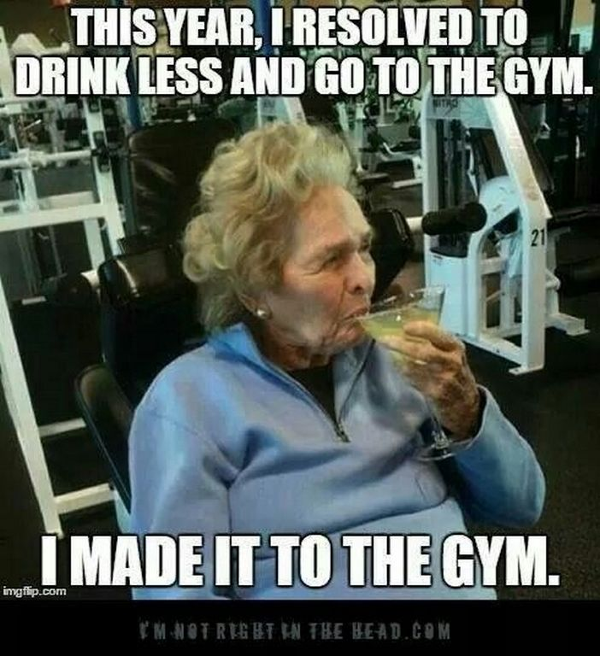
SQL DBA’s

Slide 20
“upgrade to / learn new capabilities of SQL 2016”
Things that haven’t changed from
SQL 2012 to SQL 2016:
Licensing
Major editions (though BI Edition is gone)
TSQL (though with some cool additions)
Your code-first design sucks
You’re still using nvarchar(max) when you shouldn’t be because it was the default

Slide 21
“upgrade to / learn new capabilities of SQL 2016”
SQL 2016 is so cool, Instead of this:
IF EXISTS (select * from sys.objects where name = ‘whatever’)
DROP TABLE whatever
GO
CREATE TABLE whatever
…
You can do this:
CREATE OR ALTER TABLE whatever
…
Or this:
DROP TABLE IF EXISTS whatever

Slide 22
“upgrade to / learn new capabilities of SQL 2016”
New stuff to look for in SQL 2016:
As of SP1, a huge number of major Enterprise features have moved to Standard edition:
SQL Audit
Row-level security
Dynamic Data Masking
CDC
Columnstore indexes
Horizontal Partitioning
Compression
Always Encrypted
In Memory OLTP tables (Hekaton)

Slide 23
“upgrade to / learn new capabilities of SQL 2016”
Also:
Management Studio and Data Tools are free downloads that are updated monthly
How to upgrade
Install SQL 2016
Backup/Restore your databases over
Eat a king cake
Done

Slide 24
Grand Finale
New habits are like going bald
Knew I needed to
Finally decided to
Was a shock initially, not just to me but everyone
Not everyone liked it
Two years later, can‘t believe I ever had hair
I encourage you to follow up on your desired new habits

